Slide 1
GAMES103: Intro to Physics-Based Animation
Linear Finite Element Method II
Huamin Wang
Dec 2021

Slide 2

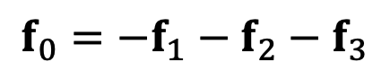
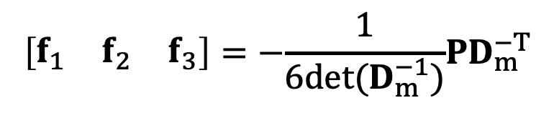
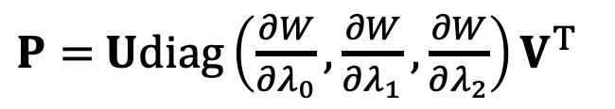
Last Time…
A FEM/FVM Framework
$$D_{m}=\left[\begin{matrix}X_{10} & X_{20} & X_{30}\end{matrix}\right]$$
Deformation gradient
$$F=\left[\begin{matrix}x_{10} & x_{20} & x_{30}\end{matrix}\right]D_{m}^{−1}$$
Principal stretches $Λ$
$$\left[\begin{matrix}U & Λ & V^{T}\end{matrix}\right]=svd(F)$$
Second PK Stress
$P=$ $Udiag\left(\frac{∂W}{∂λ_{0}},\frac{∂W}{∂λ_{1}},\frac{∂W}{∂λ_{2}}\right)V^{T}$
$$\left[\begin{matrix}f_{1} & f_{2} & f_{3}\end{matrix}\right]=−\frac{1}{6det(D_{m}^{−1})}PD_{m}^{−T}$$
Forces
$$f_{0}=−f_{1}−f_{2}−f_{3}$$

Slide 3
Topics for the Day
Hessian of Elastic Energy
Implicit Integration
Nonlinear optimization

Slide 4
Hessian of Elastic Energy

Slide 5
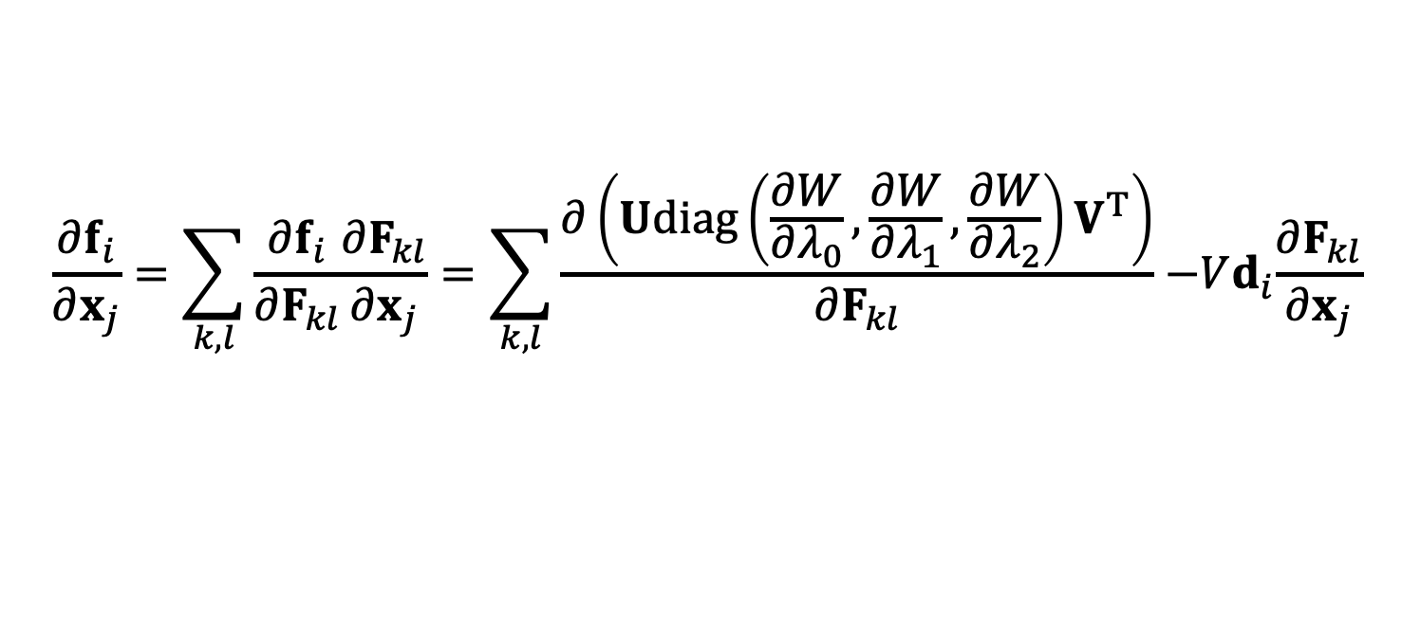
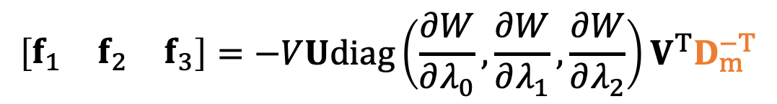
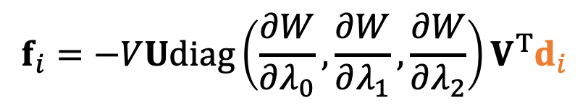
Recall that…
Forces:
$$\left[\begin{matrix}f_{1} & f_{2} & f_{3}\end{matrix}\right]=−VUdiag\left(\frac{∂W}{∂λ_{0}},\frac{∂W}{∂λ_{1}},\frac{∂W}{∂λ_{2}}\right)V^{T}D_{m}^{−T}$$
$$\left[\begin{matrix}f_{0} & f_{1} & f_{2} & f_{3}\end{matrix} \right]=−VUdiag\left(\frac{∂W}{∂λ_{0}},\frac{∂W}{∂λ_{1}},\frac{∂W}{∂λ_{2}}\right)V^{T}\left[\begin{matrix}d_{0} & d_{1} & d_{2} & d_{3}\end{matrix} \right]$$
$$f_{i}=−VUdiag\left(\frac{∂W}{∂λ_{0}},\frac{∂W}{∂λ_{1}},\frac{∂W}{∂λ_{2}}\right)V^{T}d_{i}$$
Energy Hessian:
$$\frac{∂f_{i}}{∂x_{j}}=\sum_{k,l}{\frac{∂f_{i}}{∂F_{kl}}\frac{∂F_{kl}}{∂x_{j}}}=\sum_{k,l}{\frac{∂\left(Udiag\left(\frac{∂W}{∂λ_{0}},\frac{∂W}{∂λ_{1}},\frac{∂W}{∂λ_{2}}\right)V^{T}\right)}{∂F_{kl}}{ −Vd}_{i}\frac{∂F_{kl}}{∂x_{j}}}$$
constant

Slide 6
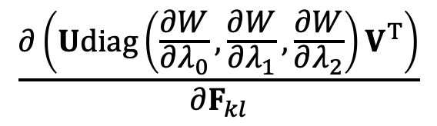
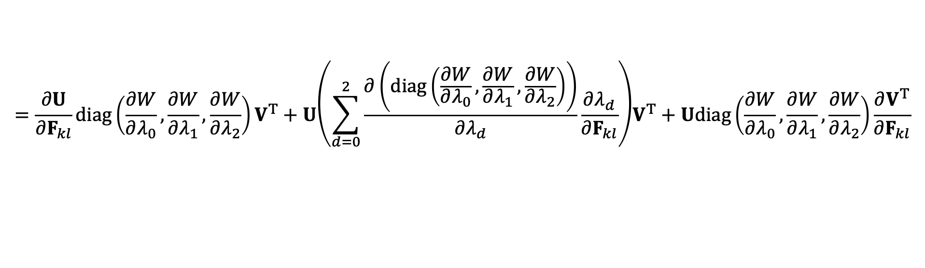

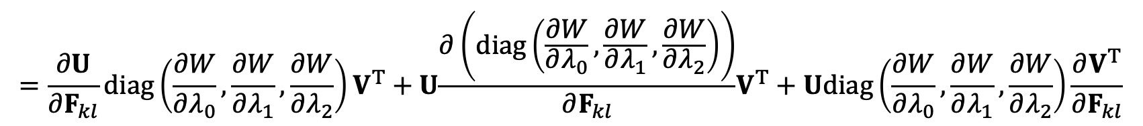
Energy Hessian
$$\frac{∂\left(Udiag\left(\frac{∂W}{∂λ_{0}},\frac{∂W}{∂λ_{1}},\frac{∂W}{∂λ_{2}}\right)V^{T}\right)}{∂F_{kl}}$$
$$=\frac{∂U}{∂F_{kl}}diag\left(\frac{∂W}{∂λ_{0}},\frac{∂W}{∂λ_{1}},\frac{∂W}{∂λ_{2}}\right)V^{T}+U{\frac{∂\left(diag\left(\frac{∂W}{∂λ_{0}},\frac{∂W}{∂λ_{1}},\frac{∂W}{∂λ_{2}}\right)\right)}{∂F_{kl}}V}^{T}+Udiag\left(\frac{∂W}{∂λ_{0}},\frac{∂W}{∂λ_{1}},\frac{∂W}{∂λ_{2}}\right)\frac{∂V^{T}}{∂F_{kl}}$$
$$=\frac{∂U}{∂F_{kl}}diag\left(\frac{∂W}{∂λ_{0}},\frac{∂W}{∂λ_{1}},\frac{∂W}{∂λ_{2}}\right)V^{T}+U{\left(\sum_{d=0}^{2}{\frac{∂\left(diag\left(\frac{∂W}{∂λ_{0}},\frac{∂W}{∂λ_{1}},\frac{∂W}{∂λ_{2}}\right)\right)}{∂λ_{d}}\frac{∂λ_{d}}{∂F_{kl}}}\right)V}^{T}+Udiag\left(\frac{∂W}{∂λ_{0}},\frac{∂W}{∂λ_{1}},\frac{∂W}{∂λ_{2}}\right)\frac{∂V^{T}}{∂F_{kl}}$$
known
known
Given by hyperelastic model
What we don’t know: $\frac{∂U}{∂F_{kl}}$, $\frac{∂λ_{d}}{∂F_{kl}}$, $\frac{∂V^{T}}{∂F_{kl}}$.

Slide 7
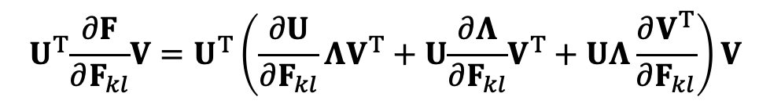
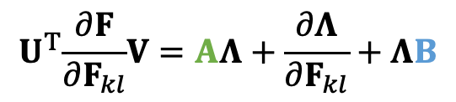
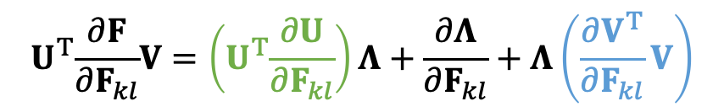
SVD Derivative
Since $F=UΛV^{T}$ is singular value decomposition ($Λ=diag(λ_{0},λ_{1},λ_{2})$), we can do:
$$U^{T}\frac{∂F}{∂F_{kl}}V=U^{T}\left(\frac{∂U}{∂F_{kl}}{ΛV}^{T}+U{\frac{∂Λ}{∂F_{kl}}V}^{T}+UΛ\frac{∂V^{T}}{∂F_{kl}}\right)V$$
$$U^{T}\frac{∂F}{∂F_{kl}}V=\left(U^{T}\frac{∂U}{∂F_{kl}}\right)Λ+\frac{∂Λ}{∂F_{kl}}+Λ\left(\frac{∂V^{T}}{∂F_{kl}}V\right)$$
$$U^{T}\frac{∂F}{∂F_{kl}}V=AΛ+\frac{∂Λ}{∂F_{kl}}+ΛB$$

Slide 8
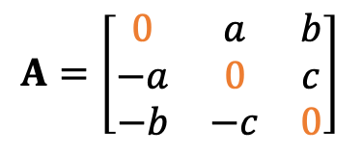
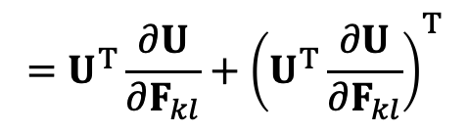
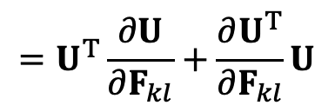
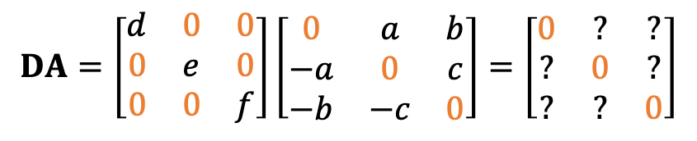
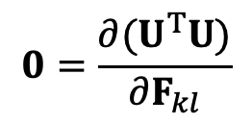
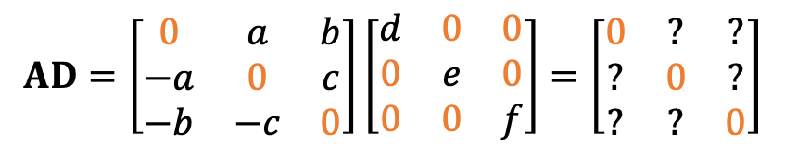
Skew-Symmetric Matrix
Matrix $A$ is skew-symmetric (or anti-symmetric), if $A=−A^{T}$:
$$A=\left[\begin{matrix}0 & a & b \\ −a & 0 & c \\ −b & −c & 0\end{matrix}\right]$$
If $D$ is diagonal, then:
$$AD=\left[\begin{matrix}0 & a & b \\ −a & 0 & c \\ −b & −c & 0\end{matrix}\right]\left[\begin{matrix}d & 0 & 0 \\ 0 & e & 0 \\ 0 & 0 & f\end{matrix}\right]=\left[\begin{matrix}0 & ? & ? \\ ? & 0 & ? \\ ? & ? & 0\end{matrix}\right]$$
$$DA=\left[\begin{matrix}d & 0 & 0 \\ 0 & e & 0 \\ 0 & 0 & f\end{matrix}\right]\left[\begin{matrix}0 & a & b \\ −a & 0 & c \\ −b & −c & 0\end{matrix}\right]=\left[\begin{matrix}0 & ? & ? \\ ? & 0 & ? \\ ? & ? & 0\end{matrix}\right]$$
When $U$ is orthogonal, we have:
$$0=\frac{∂(U^{T}U)}{∂F_{kl}}$$
$$=U^{T}\frac{∂U}{∂F_{kl}}+\frac{∂U^{T}}{∂F_{kl}}U$$
$$=U^{T}\frac{∂U}{∂F_{kl}}+{\left(U^{T}\frac{∂U}{∂F_{kl}}\right)}^{T}$$
Therefore, $A=U^{T}\frac{∂U}{∂F_{kl}}$ is skew-symmetric. So is $B=\frac{∂V^{T}}{∂F_{kl}}$ $V$.

Slide 9
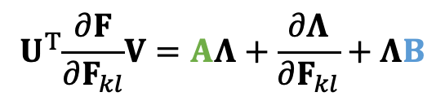
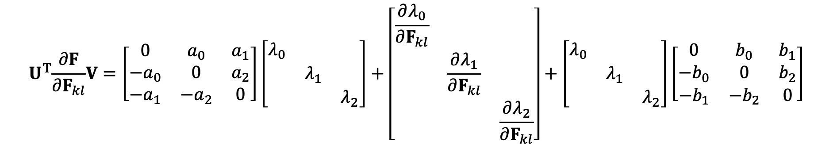
SVD Derivative (cont.)
Since $F=UΛV^{T}$ is singular value decomposition ($Λ=diag(λ_{0},λ_{1},λ_{2})$), we can do:
$$U^{T}\frac{∂F}{∂F_{kl}}V=AΛ+\frac{∂Λ}{∂F_{kl}}+ΛB$$
After expansion, we get:
$$U^{T}\frac{∂F}{∂F_{kl}}V=\left[\begin{matrix}0 & a_{0} & a_{1} \\ −a_{0} & 0 & a_{2} \\ −a_{1} & −a_{2} & 0\end{matrix}\right]\left[\begin{matrix}λ_{0} & & \\ & λ_{1} & \\ & & λ_{2}\end{matrix}\right]+\left[\begin{matrix}\frac{∂λ_{0}}{∂F_{kl}} & & \\ & \frac{∂λ_{1}}{∂F_{kl}} & \\ & & \frac{∂λ_{2}}{∂F_{kl}}\end{matrix}\right]+\left[\begin{matrix}λ_{0} & & \\ & λ_{1} & \\ & & λ_{2}\end{matrix}\right]\left[\begin{matrix}0 & b_{0} & b_{1} \\ −b_{0} & 0 & b_{2} \\ −b_{1} & −b_{2} & 0\end{matrix}\right]$$

Slide 10
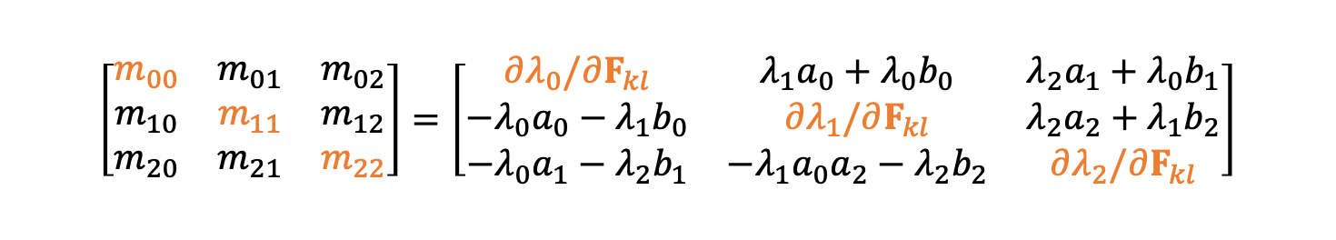
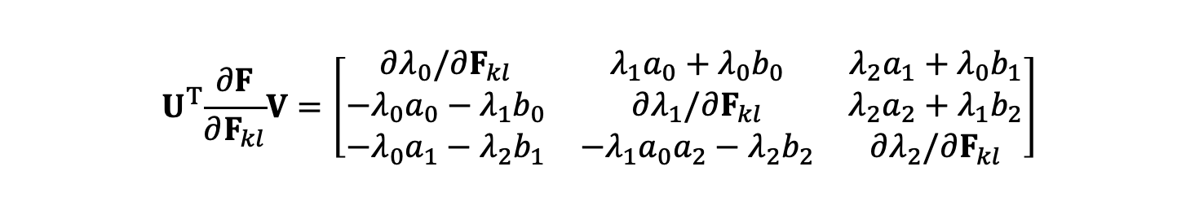
SVD Derivative (cont.)
Since $F=UΛV^{T}$ is singular value decomposition ($Λ=diag(λ_{0},λ_{1},λ_{2})$), we can do:
$$U^{T}\frac{∂F}{∂F_{kl}}V=AΛ+\frac{∂Λ}{∂F_{kl}}+ΛB$$
After expansion, we get:
$$U^{T}\frac{∂F}{∂F_{kl}}V=\left[\begin{matrix}∂λ_{0}/∂F_{kl} & {λ_{1}a}_{0}+λ_{0}b_{0} & {λ_{2}a}_{1}+{λ_{0}b}_{1} \\ −{λ_{0}a}_{0}−{λ_{1}b}_{0} & ∂λ_{1}/∂F_{kl} & {λ_{2}a}_{2}+{λ_{1}b}_{2} \\ −λ_{0}a_{1}−{λ_{2}b}_{1} & −{{λ_{1}a}_{0}a}_{2}−{λ_{2}b}_{2} & ∂λ_{2}/∂F_{kl}\end{matrix}\right]$$
$$\left[\begin{matrix}m_{00} & m_{01} & m_{02} \\ m_{10} & m_{11} & m_{12} \\ m_{20} & m_{21} & m_{22}\end{matrix}\right]=\left[\begin{matrix}∂λ_{0}/∂F_{kl} & {λ_{1}a}_{0}+λ_{0}b_{0} & {λ_{2}a}_{1}+{λ_{0}b}_{1} \\ −{λ_{0}a}_{0}−{λ_{1}b}_{0} & ∂λ_{1}/∂F_{kl} & {λ_{2}a}_{2}+{λ_{1}b}_{2} \\ −λ_{0}a_{1}−{λ_{2}b}_{1} & −{{λ_{1}a}_{0}a}_{2}−{λ_{2}b}_{2} & ∂λ_{2}/∂F_{kl}\end{matrix}\right]$$
Eventually, we get: $A=U^{T}\frac{∂U}{∂F_{kl}}$, $B=\frac{∂V^{T}}{∂F_{kl}}$ $V$ and $∂λ_{0}/∂F_{kl}$, $∂λ_{1}/∂F_{kl}$, $∂λ_{2}/∂F_{kl}$.

Slide 11
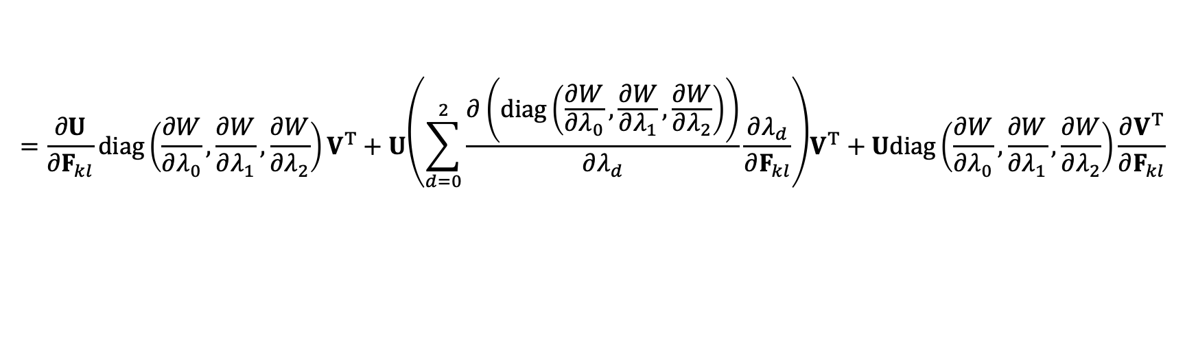
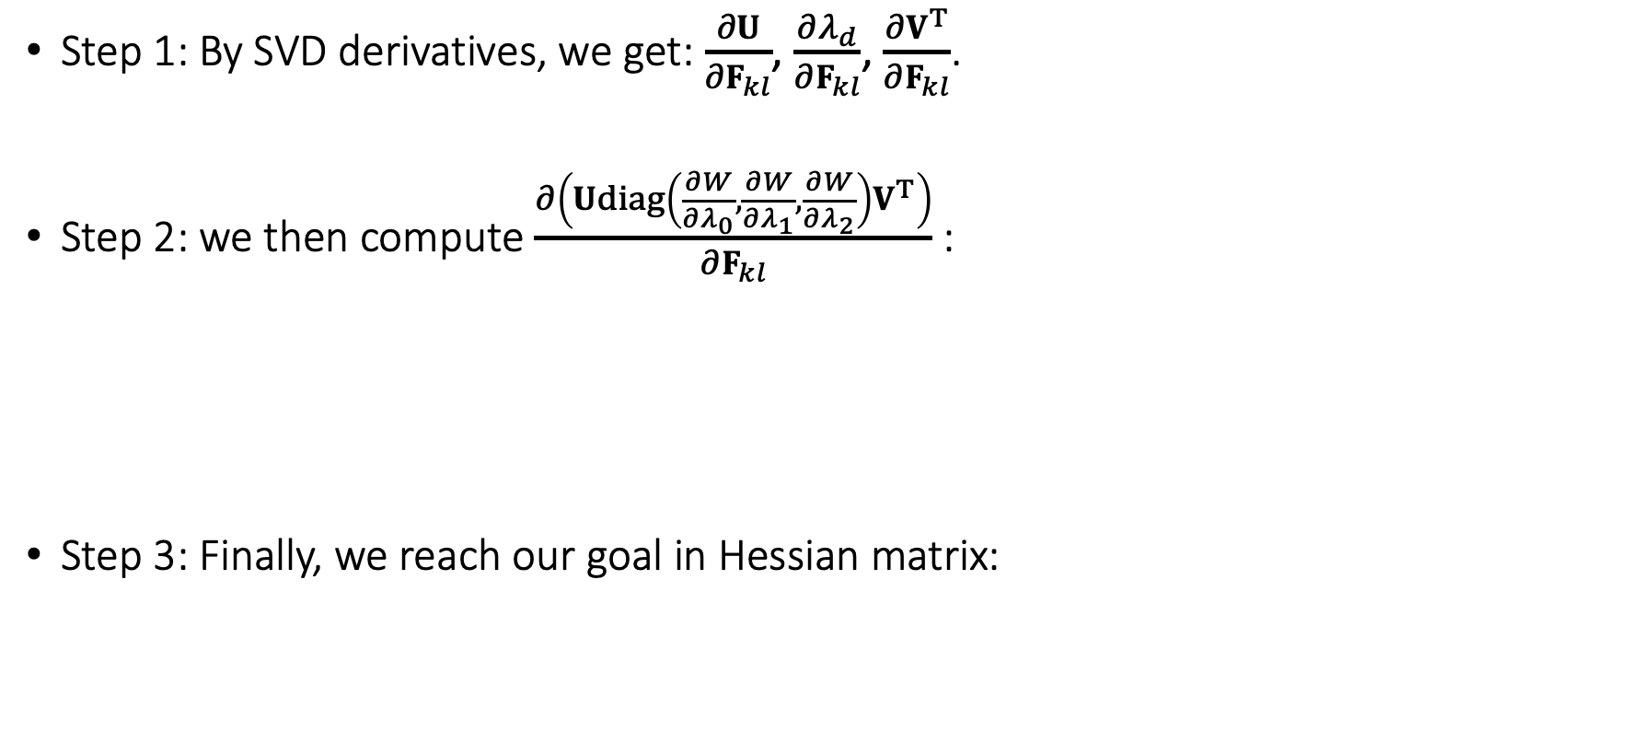
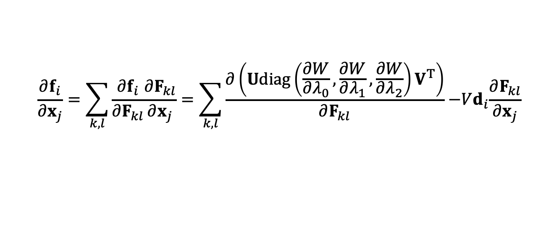
A Quick Summary
Step 1: By SVD derivatives, we get: $\frac{∂U}{∂F_{kl}}$, $\frac{∂λ_{d}}{∂F_{kl}}$, $\frac{∂V^{T}}{∂F_{kl}}$.
Step 2: we then compute $\frac{∂\left(Udiag\left(\frac{∂W}{∂λ_{0}},\frac{∂W}{∂λ_{1}},\frac{∂W}{∂λ_{2}}\right)V^{T}\right)}{∂F_{kl}}$:
Step 3: Finally, we reach our goal in Hessian matrix:
$$=\frac{∂U}{∂F_{kl}}diag\left(\frac{∂W}{∂λ_{0}},\frac{∂W}{∂λ_{1}},\frac{∂W}{∂λ_{2}}\right)V^{T}+U{\left(\sum_{d=0}^{2}{\frac{∂\left(diag\left(\frac{∂W}{∂λ_{0}},\frac{∂W}{∂λ_{1}},\frac{∂W}{∂λ_{2}}\right)\right)}{∂λ_{d}}\frac{∂λ_{d}}{∂F_{kl}}}\right)V}^{T}+Udiag\left(\frac{∂W}{∂λ_{0}},\frac{∂W}{∂λ_{1}},\frac{∂W}{∂λ_{2}}\right)\frac{∂V^{T}}{∂F_{kl}}$$
$$\frac{∂f_{i}}{∂x_{j}}=\sum_{k,l}{\frac{∂f_{i}}{∂F_{kl}}\frac{∂F_{kl}}{∂x_{j}}}=\sum_{k,l}{\frac{∂\left(Udiag\left(\frac{∂W}{∂λ_{0}},\frac{∂W}{∂λ_{1}},\frac{∂W}{∂λ_{2}}\right)V^{T}\right)}{∂F_{kl}}{ −Vd}_{i}\frac{∂F_{kl}}{∂x_{j}}}$$

Slide 12
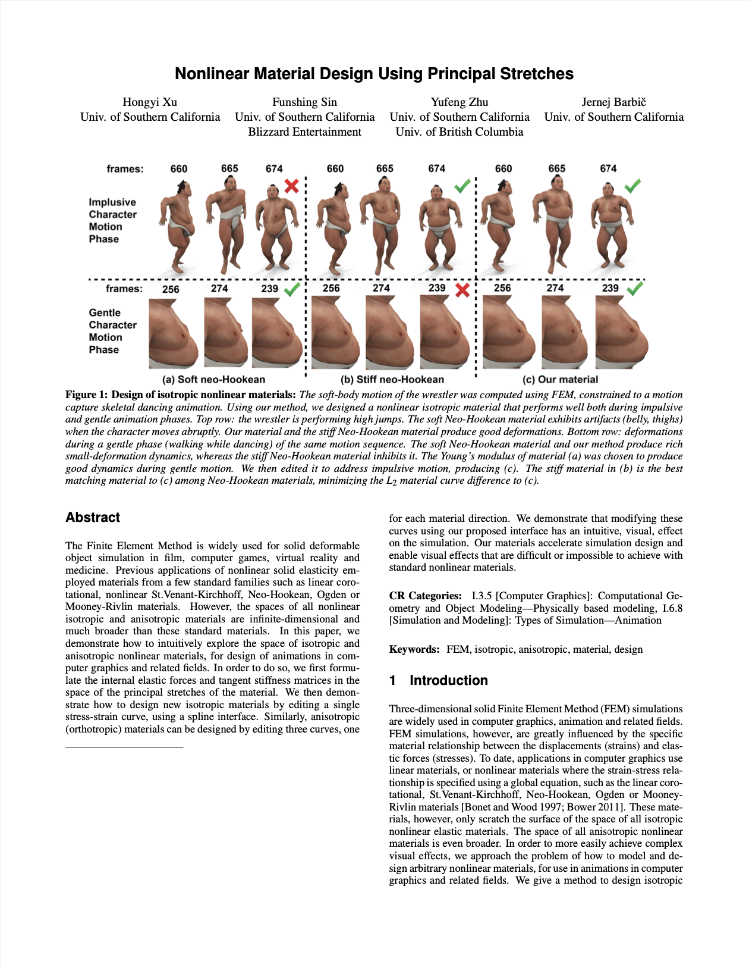
After-Class Reading
Xu et al. 2015. Nonlinear Material Design Using Principal Stretches. TOG (SIGGRAPH).
Definitely read this paper if you decide to implement it.

Slide 13
Implicit Integration

Slide 14
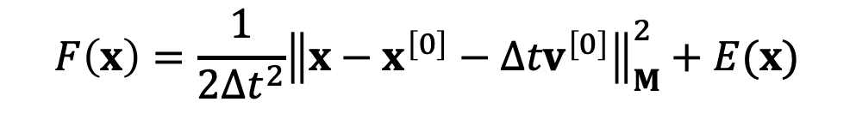
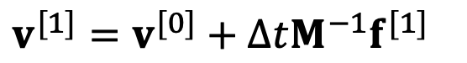
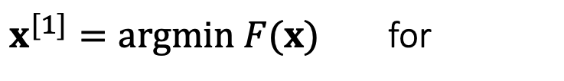
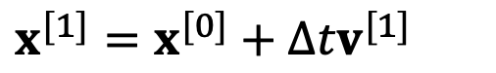
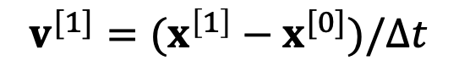
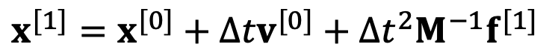
Implicit Integration
Recall that we need implicit integration to avoid numerical instability (Class 5, page 13):
$v^{[1]}=v^{[0]}+{∆tM^{−1}f}^{[1]}$
$$x^{[1]}=x^{[0]}+{∆tv}^{[0]}+{∆t^{2}M^{−1}f}^{[1]}$$
or
$x^{[1]}=x^{[0]}+{∆tv}^{[1]}$
$$v^{[1]}=(x^{\left[1\right]}−x^{[0]})/∆t$$
We also said that:
$$x^{[1]}=x^{[0]}+{∆tv}^{[0]}+∆t^{2}M^{−1}f(x^{[1]})$$
$$F\left(x\right)=\frac{1}{2∆t^{2}}{\left\|x−x^{\left[0\right]}−{∆tv}^{\left[0\right]}\right\|}_{M}^{2}+E(x)$$
$x^{[1]}=argmin F(x)$ for

Slide 15
Newton-Raphson Method
The Newton-Raphson method, commonly known as Newton’s method, solves the optimization problem: $x^{[1]}=argmin F\left(x\right)$. ($F\left(x\right)$ is Lipschitz continuous.)
Given a current $x^{(k)}$, we approximate our goal by:
$$0=F′\left(x\right)≈F′\left(x^{\left(k\right)}\right)+F′′\left(x^{(k)}\right)\left(x−x^{(k)}\right)$$
Newton’s Method
$$F(x)$$
Initialize $x^{\left(0\right)}$
For $k=0…K$
$$∆x←−{\left(F^{′′}\left(x^{\left(k\right)}\right)\right)}^{−1}F′\left(x^{\left(k\right)}\right)$$
$$x^{\left(k+1\right)}←x^{\left(k\right)}+∆x$$
If $|∆x|$ is small then break
$$x^{\left[1\right]}←x^{\left(k+1\right)}$$
$$F^{′}\left(x\right)=0$$
$$x$$

Slide 16
Newton-Raphson Method
Now we can apply Newton’s method to: $x^{[1]}=argmin F\left(x\right)$.
Given a current $x^{(k)}$, we approximate our goal by:
$0=∇F\left(x\right)≈∇F\left(x^{(k)}\right)+\frac{∂F^{2}\left(x^{(k)}\right)}{∂x^{2}}\left(x−x^{(k)}\right)$
Newton’s Method
Initialize $x^{\left(0\right)}$
For $k=0…K$
$$∆x←−{\left(\frac{∂F^{2}\left(x^{(k)}\right)}{∂x^{2}}\right)}^{−1}∇F\left(x^{(k)}\right)$$
$$x^{\left(k+1\right)}←x^{\left(k\right)}+∆x$$
If $\left\|∆x\right\|$ is small then break
$$x^{\left[1\right]}←x^{\left(k+1\right)}$$

Slide 17
Simulation by Newton’s Method
$$F\left(x\right)=\frac{1}{2∆t^{2}}{\left\|x−x^{\left[0\right]}−{∆tv}^{\left[0\right]}\right\|}_{M}^{2}+E(x)$$
Specifically to simulation, we have:
$$∇F\left(x^{(k)}\right)=\frac{1}{∆t^{2}}M\left(x^{(k)}−x^{\left[0\right]}−{∆tv}^{\left[0\right]}\right)−f\left(x^{(k)}\right)$$
$$\frac{∂^{2}F\left(x^{(k)}\right)}{∂x^{2}}=\frac{1}{∆t^{2}}M+H\left(x^{\left(k\right)}\right)$$
Initialize $x^{\left(0\right)}$, often as $x^{\left[0\right]}$ or $x^{\left[0\right]}$ $+{∆tv}^{\left[0\right]}$
For $k=0…K$
$$\left(\frac{1}{∆t^{2}}M+H\left(x^{\left(k\right)}\right)\right)∆x=− \frac{1}{∆t^{2}}M\left({x^{\left(k\right)}−x}^{\left[0\right]}−{∆tv}^{\left[0\right]}\right)+f\left(x^{\left(k\right)}\right)$$
Solve
$$x^{\left(k+1\right)}←x^{\left(k\right)}+∆x$$
If $\left\|∆x\right\|$ is small then break
$$x^{\left[1\right]}←x^{\left(k+1\right)}$$
$v^{\left[1\right]}←\left(x^{\left[1\right]}−x^{\left[0\right]}\right)/$ $∆t$

Slide 18
Nonlinear Optimization

Slide 19
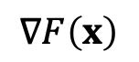
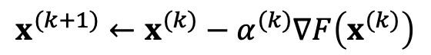
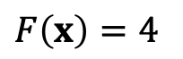

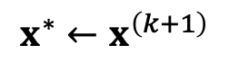


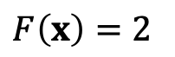

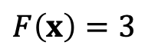
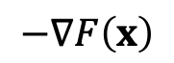
Gradient Descent
Another way to solve $x^{∗}=argmin F\left(x\right)$ is the gradient descent method.
Gradient Descent
Initialize $x^{\left(0\right)}$
$$−∇F\left(x\right)$$
$$x$$
For $k=0…K$
$$x^{(k+1)}←x^{(k)}−α^{(k)}∇F\left(x^{(k)}\right)$$
$$∇F\left(x\right)$$
$$x^{∗}←x^{\left(k+1\right)}$$
$$x^{∗}$$
$F\left(x\right)=2$
Step size
$F\left(x\right)=3$
How to find the optimal step size becomes a critical question.
$F\left(x\right)=4$

Slide 20

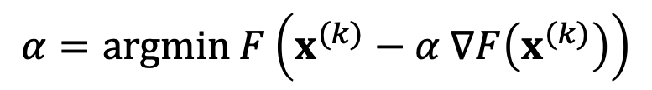
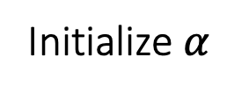
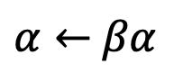
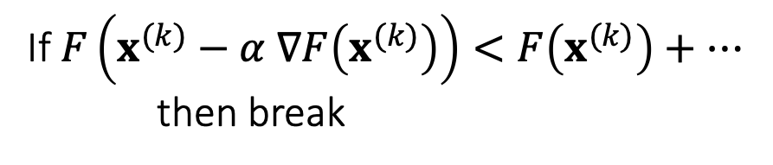
Line Search Methods
There two popular line search methods for step size adjustment.
Exact Line Search
Backtracking Line Search
Initialize $α$
Wolfe Conditions
Tries to solve:
For $l=0…∞$
$$α=argmin F\left(x^{(k)}−α ∇F\left(x^{(k)}\right)\right)$$
If $F\left(x^{(k)}−α ∇F\left(x^{(k)}\right)\right)<F\left(x^{(k)}\right)+…$
then break
$α←$ $βα$
Fast convergence
simple
Low overhead
Large Overhead
Complicated

Slide 21
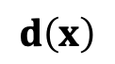

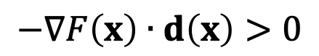
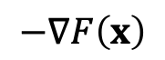
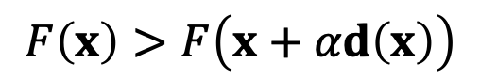
Descent Directions
The direction $d\left(x\right)$ is descending, if a sufficiently small step size $α$ exists for:
$$F\left(x\right)>F\left(x+αd\left(x\right)\right)$$
In other words,
$$−∇F\left(x\right)$$
$$−∇F\left(x\right)∙d\left(x\right)>0$$
$$d\left(x\right)$$
$$x$$
$$x^{∗}$$
$F\left(x\right)=2$
$F\left(x\right)=3$
not descending
descending
$F\left(x\right)=4$

Slide 22
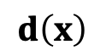
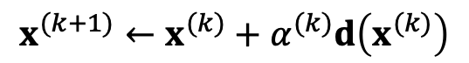
Descent Methods
With line search, we can use any search direction as long as it’s descending:
$$F\left(x^{(0)}\right)>F\left(x^{(1)}\right)>F\left(x^{(2)}\right)>F\left(x^{(3)}\right)>…$$
Descent Methods
Initialize $x^{\left(0\right)}$
$$x$$
For $k=0…K$
$$x^{(k+1)}←x^{(k)}+α^{(k)}d\left(x^{(k)}\right)$$
$$d\left(x\right)$$
$$x^{∗}←x^{\left(k+1\right)}$$
$$x^{∗}$$
$F\left(x\right)=2$
$F\left(x\right)=3$
$F\left(x\right)=4$

Slide 23
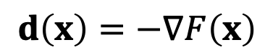





Descent Methods
Gradient descent is a descent method, since:
Newton’s method is also a descent method, if the Hessian is always positive definite:
Any method using a positive definite matrix P to modify the gradient yields a descent method:
$$d\left(x\right)=−∇F\left(x\right)$$
$$−∇F\left(x\right)∙\left(−∇F\left(x\right)\right)>0$$
$$d\left(x\right)=−{\left(\frac{∂^{2}F\left(x\right)}{∂x^{2}}\right)}^{−1}∇F\left(x\right)$$
$$−∇F\left(x\right)∙\left(−{\left(\frac{∂^{2}F\left(x\right)}{∂x^{2}}\right)}^{−1}∇F\left(x\right)\right)>0$$
$$d\left(x\right)=−P^{−1}∇F\left(x\right)$$
$$−∇F\left(x\right)∙\left(−P^{−1}∇F\left(x\right)\right)>0$$

Slide 24









Descent Methods
Descent Methods
Initialize $x^{\left(0\right)}$
A unified descent framework
For $k=0…K$
$$x^{(k+1)}←x^{(k)}−α^{\left(k\right)}{\left(P^{\left(k\right)}\right)}^{−1}∇F\left(x^{(k)}\right)$$
$$x^{∗}←x^{\left(k+1\right)}$$
Gradient
Descent
[Wang et al. 2015]
Projective Dynamics
Newton’s Method
[Fratarcangeli et al. 2016]
$$P^{\left(k\right)}=I$$
$$P^{\left(k\right)}=diag\left(\frac{∂^{2}F\left(x\right)}{∂x^{2}}\right)$$
$$P^{\left(k\right)}=lower\left(\frac{∂^{2}F\left(x\right)}{∂x^{2}}\right)$$
$$P^{\left(k\right)}=Const$$
$$P^{\left(k\right)}=\frac{∂^{2}F\left(x\right)}{∂x^{2}}$$
Different $P^{\left(k\right)}$
Cheap iterations
Few iterations
Many iterations
Costly iterations

Slide 25
Descent Methods
Gradient
Descent
Total Cost=Per-Iteration Cost * Number of Iterations
Number of Iterations
[Wang et al. 2015]
Projective Dynamics
Newton’s Method
[Fratarcangeli et al. 2016]
Per-Iteration Cost

Slide 26

Comparisons
Wang. 2016. Descent Methods for Elastic Body Simulation on the GPU. TOG (SIGGRAPH Asia).

Slide 27

After-Class Reading
Wang. 2016. Descent Methods for Elastic Body Simulation on the GPU. TOG (SIGGRAPH Asia).

Slide 28
A Summary For the Day
We can calculate the Hessian of the FEM elastic energy based on SVD derivatives.
The goal of doing this is for implicit time integration.
Fundamentally, the goal is to solve a nonlinear optimization.
Gradient Descent, Newton’s method, and others can all be considered as descent methods.
The key question is the matrix for calculating the search direction.
We need both the per-iteration cost and the number of iterations to be small.

